Slide 1

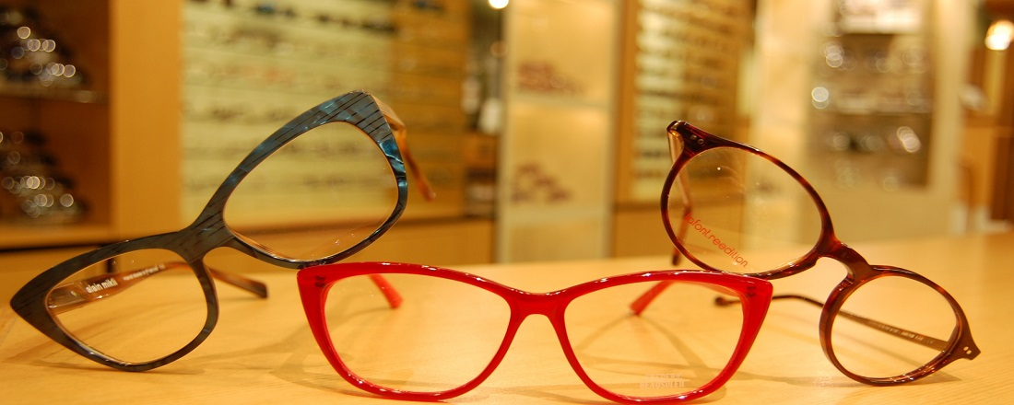
eEyewear (eeyewear)

Slide 2
eeyewear b2b Store
Presented by-
Ravi Ranjan Kumar Pandey
Madhu Sudhan
Arfaat Afzal Kirkire
Shalini Gupta

Slide 3
Objective, Prerequisites and Agenda of eeyewear
OBJECTIVE:
To provide customers to buy Eyewears online .
AGENDA:
Demonstration of the Store.
Implementation.
PREREQUISITES
Software requirements:
Windows 7 OS (64 bit)
SAP Hybris 6.0
Java (jdk 1.8).
Apache Ant
Apache Tomcat Web Server.
HSQL(Database)
Hardware requirements:
Processor: i5 or i7.
RAM : 8GB or more.
HardDisk : 100 GB or more

Slide 4
USER STORY:
b2b store setup for eeyewear.
Customize eeyewear Store.
eeyewear Catalog setup.
eeyewear Product Catalog classification.
eeyewear Content Catalog classification.
Customize Shipping method.
Define Variants, Promotions, Vouchers
Customize Coming Soon Products.
Customize Registration to add new attributes.
Customize PDP to define new attributes.
Customize Update My account tab for new attributes
Implement WCMS Cockpit Customization , Hot Folder.
Implement PickUp in Store

Slide 5
High Level System Architecture
Eeyewear cockpit
Web services
others
eeyewear hmc
web services
others
eeyewear business services
(Classification,Prices calculation,CMS..)
eeyewear Model Classes
eeyewearInfrastructure services
(Cache,Security,Transaction,Session)
eeyewearinfrastructure services
(Cache,Security,Transaction,Session)
eeyewear Service Layer Framework
eeyewear Persistence
eeyewear Items
HSQLDatabase

Slide 6
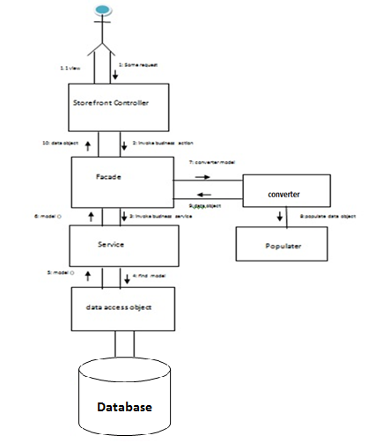
Sequence Diagram

Slide 7
Environment Setup
Installing Java
If you do not have a JDK installed, download the latest version of JDK 8 from Oracle.
Select the JDK you require and follow the installation instructions
If not already done, set your JAVA_HOME environment variable to point to the JDK directory
Open a command line (with administrator rights) and type javac -version.
How To set Environment variable
From the desktop, right click the Computer icon.
Choose Properties from the context menu.
Click the Advanced system settings link.
Click Environment Variables. In the section System Variables, find the
PATH environment variable and select it. Click Edit. If the PATH environment variable does not exist, click New.
In the Edit System Variable (or New System Variable) window, specify the value of the PATHenvironment variable. Click OK. Close all remaining windows by clicking OK.Reopen Command prompt window, and run your java code.

Slide 8
Installation
Approach for installation.
To get started, we'll download and install the hybris Commerce Suite.
Setup Hybris 6.0 environment.
Extract zip file.
Navigate to the {HYBRIS_HOME}/installer>install.bat -r b2b_acc (OR) install.bat -r b2b_acc_plus
This command to generate config, data, log, roles and temp folders
Open command prompt: Change to the hybris/bin/platform>setant.env & Run ant clean all
To create a completely new storefront (eeyewear Store ).
{HYBRIS_HOME}\hybris\bin\platform>ant modulegen -Dinput.module=accelerator -Dinput.name=eeyewear
-Dinput.package=com. eeyewear-Dinput.template=develop
This command generates 7 new extensions.
Add those extensions under config/localextensions.xml.
After this step you should have 7 custom extensions in custom folder, that have been adopted to your project's namespace.
/custom/eeyewearscore
/custom/eeyewearcockpits
/custom/eeyewear/eeyewearfacades
/custom/eeyewear/eeyewearfulfilmentprocess
/custom/eeyewear/eeyewearnitialdata
/custom/eeyewear/eeyewearstorefront
/custom/eeyewear/eeyeweartest
→Setup new eclipse workspace and import the extensions mentioned in localextensions.xml.
We can define a custom webroot for the store:
Modify this eeyewearstorefront/extensioninfo.xml.
<webmodule jspcompile="false" webroot="/eeyewearstorefront"/>
/config/local.properties
eeyewearstorefront.webroot=/eeyewearstorefront storefrontContextRoot=/eeyewearstorefront website.eeyewear.http=http://eeyewear.local:9001/eeyeweartsorefront website.eeyewear.https=https://eeyewearlocal:9002/eeyeweartstorefront
In addition, we have to modify local. properties to override properties defined in eeyewearstorefront
Now rebuild the code base (ant clean all)
Navigate to Platform
Once ant clean all has completed successfully, start the server & initialize your system from Hybris Administration Console( http://localhost:9001).

Slide 9
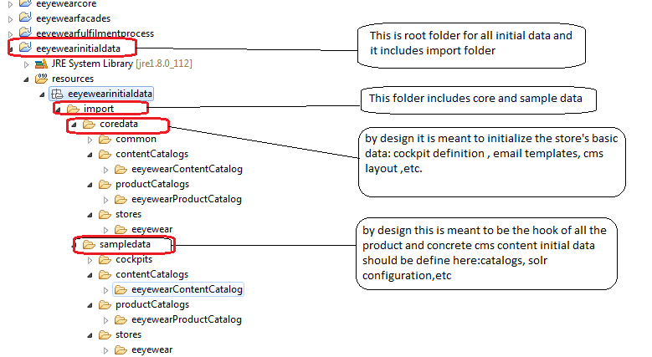
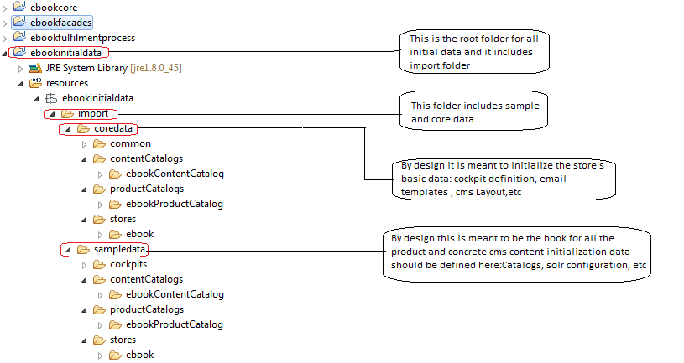
Implementation Approach
Customize Initialization Process to Develop eeyewear Store:
In CoreSystemSetup.java, an importImpexFile() is called specifying the desired impex file which will have to be added to the createProjectData() method.
In InitialDataSystemSetup.java, the createProjectData() method delegates the import operation to the CoreDataImportService and SampleDataImportService classes.
Rename the folders inside Coredata and Sampledata as the following.
9

Slide 10
Core data Impex files
Name of the Impex File | Description | Sample Impex File | Mandatory Attributes | Optional Attributes
Store.impex | This file contains store related information. |  | productCatalog, currencies, net, storeUid, defaultCurrency, defaultLanguage, deliveryCountries, orderProcessCode, pickupInStoreMode, paymentProvider, promoGrp, languages, unitedKingdom, europeNotUK, | promoGrp, checkoutFlowGroup
Store-en.impex | This file adds English localized attribute values for the basic store items. |  | Lang, storeUid | N/A
Site.impex | This file adds basic site information to the configuration of the eeyewear shop |  | productCatalog, contentCatalog, contentCV, defaultLanguage, storeUid, siteUid, siteMapUrlLimitPerFile, promoGrp | siteMapLangCur, siteMapPage, customSiteMapUrls
Site_en.impex | Provide English-language localization for the eeyewear CMSSite. |  | Lang | N/A
Solr.impex | Update the basic solr configuration, including information for ranges, facets, index names, etc. |  | Prefix, productCatalog, catalogVersions, serverConfigName, indexConfigName, searchConfigName, facetSearchConfigName, facetSearchConfigDescription, searchIndexNamePrefix, solrIndexedType, indexBaseSite, indexLanguages | solrIndexedType

Slide 11
Implementation Approach
Coredata/eeyewear Content Catalog: coredata/ eeyewear Product Catalog:
Name of the Impex File | Description | Sample Impex File | Mandatory Attributes | Optional Attributes
catalog.impex | The eeyewear Content Catalog. |  | contentCatalog ,lang
catalog_en.impex | Here edit the related localization. |  | contentCatalog ,lang
cms-content.impex | Now the Master CMS content, which defines all of the content slots for the templates, naming the templates.It does not rely on any specific product/category content. |  | contentCatalog, contentCV | PageTemplate, frontendTemplateName, ContentSlotName, SearchResultsGridPageTemplate,
cms-content_en.impex | The related localized attributes values - again check the file content and rename the catalog as eeyewearContent Catalog. |  | contentCatalog | ContentPage
Name of the Impex File | Description | Sample Impex File | Mandatory Attributes | Optional Attributes
catalog.impex | Update the product catalog impex file. |  | productCatalog, languages | CatalogIdCatalogVersion
catalog_en.impex | Do the same as above for the localized catalog data. |  | productCatalog, lang | N/A

Slide 12
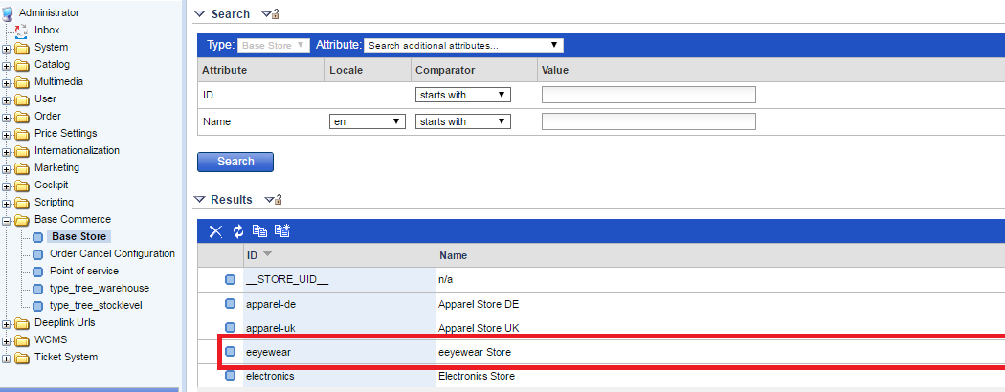
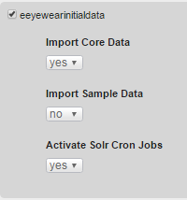
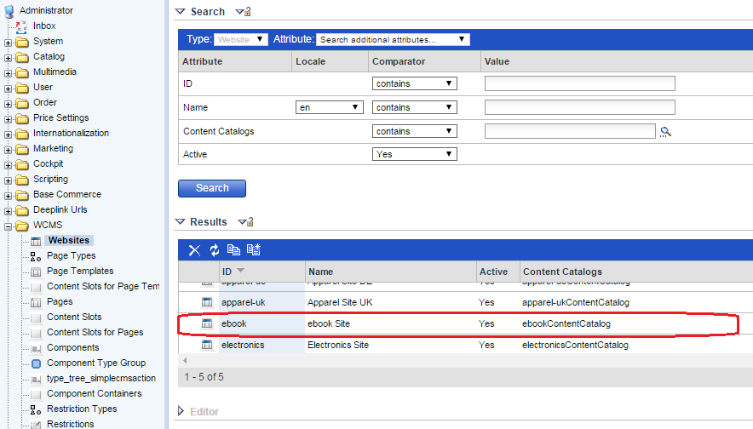
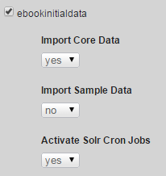
Implementation Approach
For creating the eeyewear b2b site using the core impexes,
we have to update the project data under eeyewearinitialdata extension.
Once imported the data, you can go to the hmc and look in the Base Commerce section that we have a new store called 'eeyewear' and it has a website assigned with the same name. The Hybris Management Console then reflects the changes and a new store called eeyewear appears among base stores.
Sample data Impex Files
Product categories, media, prices, stocklevels and warehouses are defined in these Impex files
Product categories:-
Name of the Impex File | Description | Sample Impex File | Mandatory Attributes | Optional Attributes
categories.impex | Imports Categories for your products. |  | productCatalog, productCatalogName | catalogVersion, supercategories, categories
categories_en.impex | Imports localized names for categories. |  | productCatalog, productCatalogName, lang | catalogVersion

Slide 13
Implementation Approach
Defining Products:-
Name of the Impex File | Description | Sample Impex File | Mandatory Attributes | Optional Attributes
products.impex | Imports products to the store to sell to the users. |  | productCatalog, productCatalogName, lang | catalogVersion, supercategories, baseProduct, approved, taxGroup
products-media.impex | Import product medias. |  | productCatalog, productCatalogName,storeName | catalogVersion, media, picture, detail, galleryImages, data_sheet
products_en.impex | Imports localized attributes of the products. |  | productCatalog, productCatalogName, lang | catalogVersion
Defining product prices:-
Name of the Impex File | Description | Sample Impex File | Mandatory Attributes | Optional Attributes
products-prices.impex | Imports prices of the products. |  | productCatalog | N/A

Slide 14
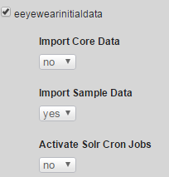
Implementation Approach
Defining stock levels:-
Name of the Impex File | Description | Sample Impex File | Mandatory Attributes | Optional Attributes
products-stocklevels.impex | Imports warehouse stocklevels for the products. |  | productCatalog, productCatalogName, ,vendor | catalogVersion
Assigning warehouse to base store:-
Name of the Impex File | Description | Sample Impex File | Mandatory Attributes | Optional Attributes
warehouses.impex | Navigate to the sampledata/stores/ eeyewear directory, and assign a warehouse to the base store. |  | storeUid | PointOfService, Address.BaseStore
Restart the server and Update your system from Hybris Administration Console(http://localhost:9001) as per below snapshot

Slide 15
Implementation Approach
SampleData Impex Files:-
Import site content
Remember that the following files are relative to the eeyewearinitialdata/resources/eeyewearinitialdata directory.
Import CMS data:-
Name of the Impex File | Description | Sample Impex File | Mandatory Attributes | Optional Attributes
cms-content.impex | Real CMS content for the eeyewear site. |  | contentCatalog, contentCatalogName, contentCV, productResource,siteResource,productCatalog, productCatalogName, | SimpleBannerComponent, MiniCartComponent, ProductAddToCartComponent,ProductVariantSelectorComponent
cms-content_en.impex | The related localized attributes values - again check the file content and rename the catalog as eeyewearContentCatalog. |  | contentCatalog, siteResource,lang | MiniCartComponent, CMSTabParagraphComponent,ProductReferencesComponent

Slide 16
Implementation Approach
Eeyewear Store Link:
http://localhost:9001/store/eeyewear/en/?site=eeyewear
https://localhost:9002/store/eeyewear/en/?site=eeyewear
The product data & cms content data will be available in the HMC
After completing this step, our eeyewearb2b site will be up.

Slide 17
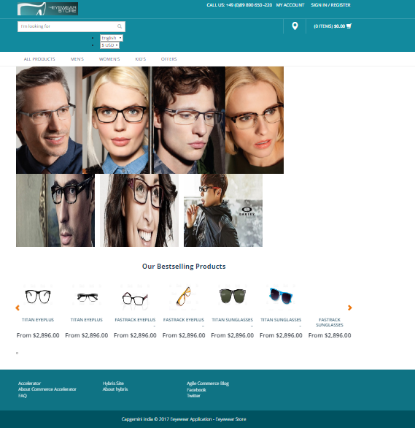

Slide 18
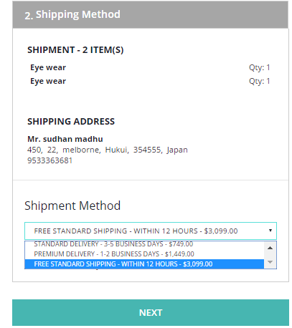
Customized Delivery Method
Name of the Impex File | Description | Sample Impex File | Mandatory Attributes | Optional Attributes
delivery-modes.impex | Create the new eeyewear delivery method “"eeyewear Standard Shipping of Documents";"2-3 business days" eeyewear; eeyewear-shipping for source and target in store.impex. delivery cost for every zone in delivery-modes.impex |  | Zone, ZoneDeliveryMode, Currencies,value | N/A
delivery-modes_en.impex | eeyewear-shipping Delivery mode of ZoneDeliveryMode in delivery-modes_en.impex |  | ZoneDeliveryMode name, description | N/A

Slide 19

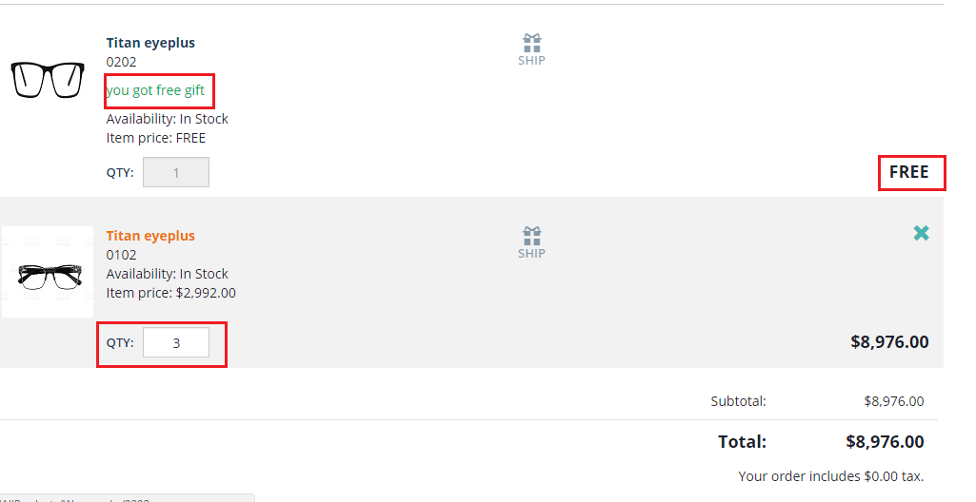
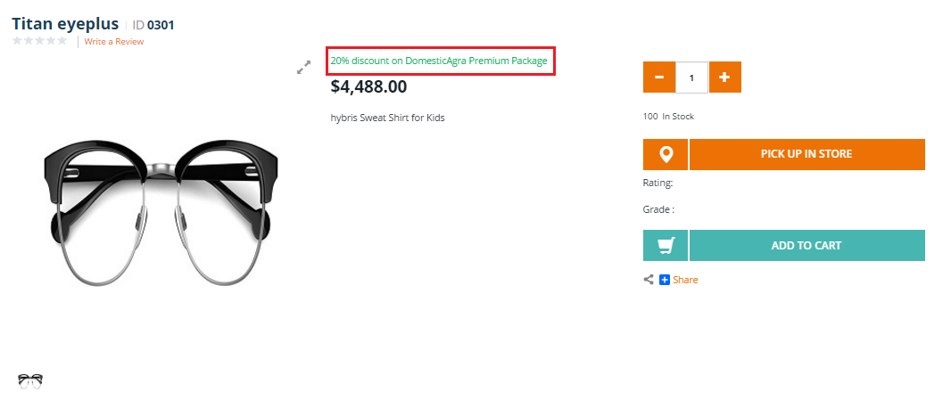
Product Level Promotion
Order Level Promotion
These promotions are activated based upon the products within the line items of a shopping cart or order.
20% percentage discount promotion for a particular product
Buy 3 Premium package's get 1 Standard package

Slide 20
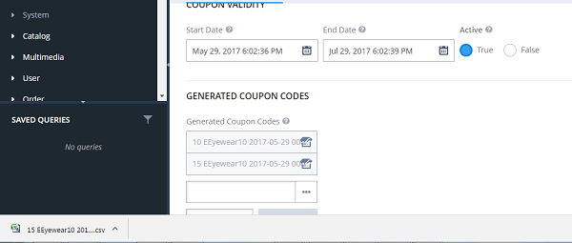
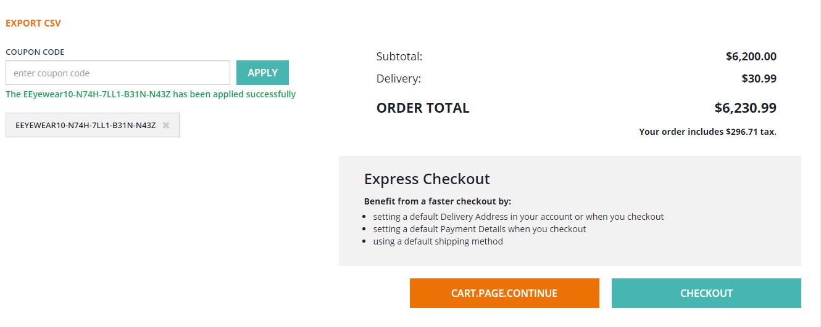
Vouchers
Serial Voucher
A voucher code for a Serial Voucher is marked invalid on redemption and cannot be used more than once.
The hybris Voucher Module keeps track of redeemed voucher codes and does not allow redeeming a single Serial Voucher code more than once.

Slide 21
.
Cont..
Promotional coupon :A coupon code for a Promotional coupon is marked valid on redemption and can be used more than once.
The hybris coupon Module keeps track of redeemed coupon codes and allows redeeming a promotional Voucher code more than once.

Slide 22
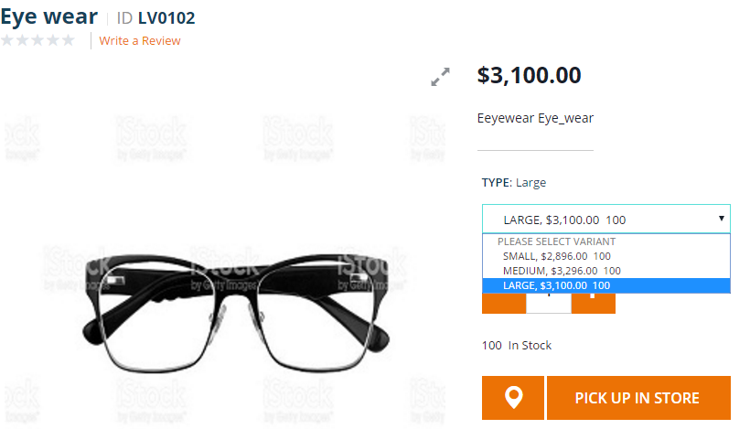
Variants
Variants are the products that differ in some aspect from one another, but are based on the base product.
We have defined eeyewearSizeVariantProduct and eeyewearStyleVariantProduct

Slide 23
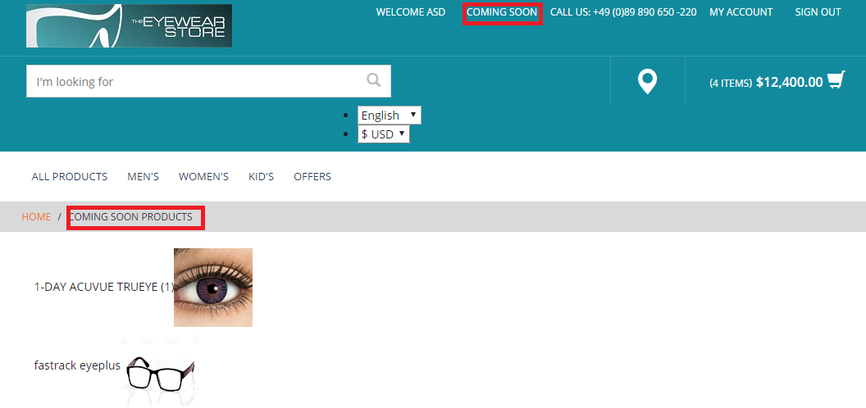
Coming Soon Products
A coming soon landing page is a sign up landing page designed to generate customer leads for a product or business that does not yet exist.
A great coming soon landing page, focuses on one primary objective: getting people to sign up before launch.
Do this right and you can build enough initial brand momentum to sustain an enormous amount of signups pre-launch
Implementation for coming soon products
Create new attribute “ComingSoon” in product itemtype in eeyewearcore-items.xml file.
Create new template for coming soon product page in coredata/cms-content.impex file.
Create controller ComingSoonController.java to redirect to that page.
Now we are going to create ComingSoonDao.java to retrieve coming soon products from product table.
Change comingSoonLayout.jsp to show your coming soon products on page
Go to Your Site and click on Coming Soon link.

Slide 24
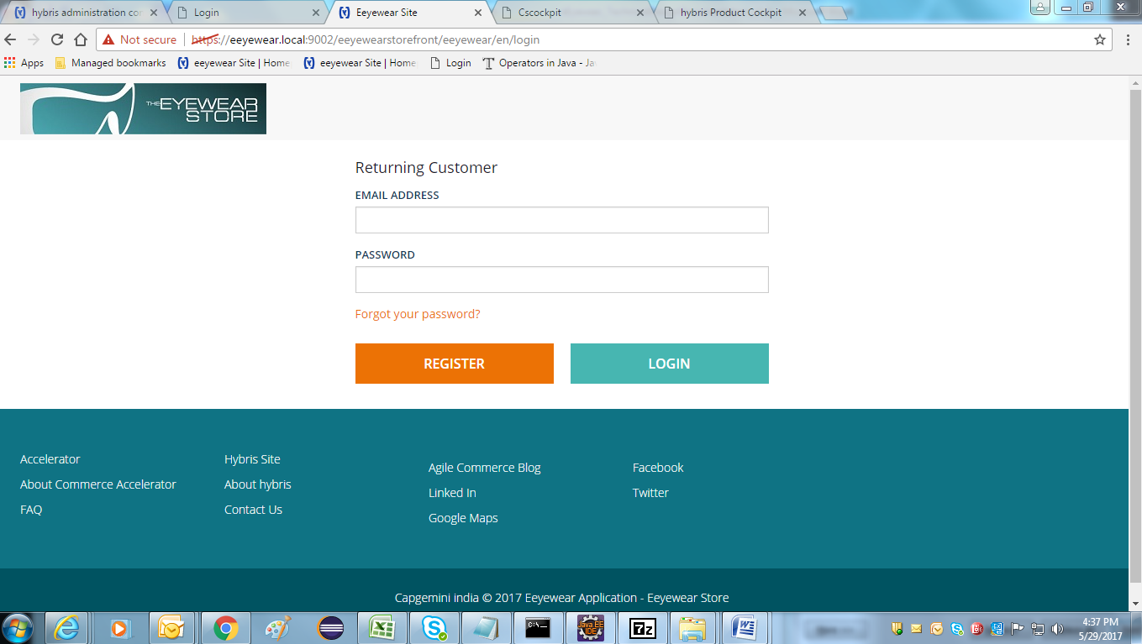
Secure Login

Slide 25
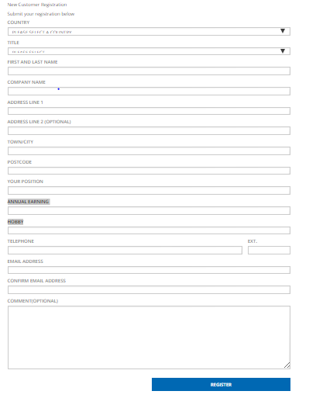
Custom Registration Implementation
We have created a template of secureportaladdon
Add an item type in your eeyewearcore-items.xml as follows and build your system and update.
Create a eeyewear registration form in custom addon with the new and existing attributes.
Add new attributes in register.tag file
Modify the SecurePortalRegistrationValidator
B2BRegistrationController.....check the method submitRegistration
CUSTOMaddon-bean.xml add the new property in the exixting B2BRegistrationData
DefaultB2BRegistrationFacade find the Method toCustomerModel & add attributes
Generate Beans in eeyewearfacade-bean.xml

Slide 26
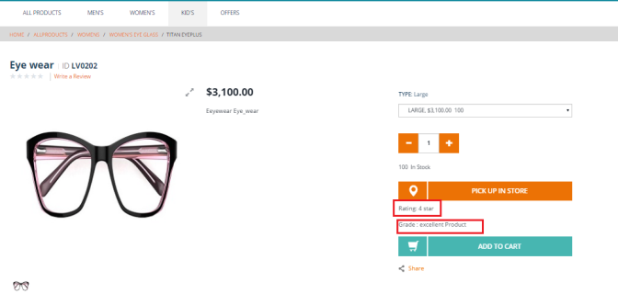
Customize PDP to define new attribute
Add an item type in your eeyewearcore-items.xml as follows and build your system and update ie Rating,grade.
Define two attribute called “Rating,CustomerSatisfaction” in items.xml file . After that ant all & Refresh the workspace, do update on eeyewearcore extension from HAC.
Open the HMC →Catalog →Product → Administration tab add new attributes under addons.
ProductPageController handles request for the addons. Add all the addons values created from HMC in the product model. Put all the attribute’s data in List. {attributesList}.
Display the data exists in the List on PDP through addtocartaction.jsp file.
Create new attribute “attribute’s ” in ProductData Bean class of eeyewearfacades-beans.xml file and in eeyewearfacades-spring.xml file created the bean id of eeyewearProductAttributsPopulator class to populate the attribute data.
ProductPageController handles request for the addons. Add all the addons values created from HMC in the product model. Put all the attribute’s data in List. {attributesList}.
Display the data exists in the List on PDP through addtocartaction.jsp file.
I have created new attribute “attributes” in ProductData Bean class of eeyewearfacades-beans.xml file
In eeyewearfacades-spring.xml file created the bean id of eeyewearProductAttributesPopulator class to populate the attribute data.

Slide 27
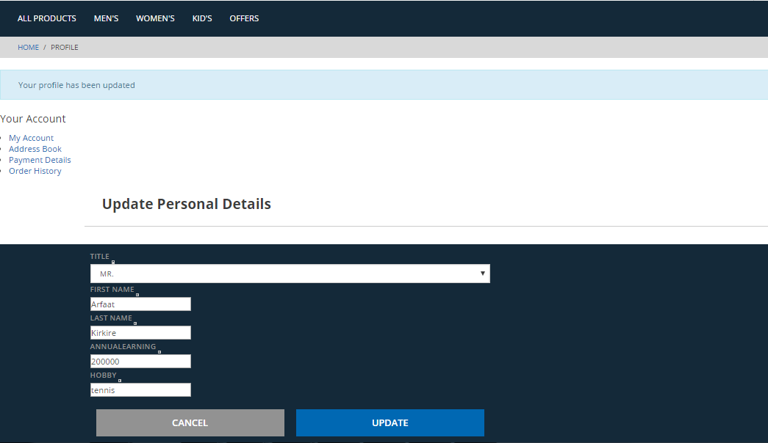
Update My Account Details
Process for Update Details:
create MyAccount CMS link component in sample data folder of cms-content.impex file.
Localize CMSLink component in cms-content_en.impex file of Sample data.
Add new Customer Register Page attributes in accountProfileEditPage.jsp file.
Create eeyewearUpdateProfileForm with new and existing attributes.
Create eeyewearUpdateProfileValidator with new and existing attributes.
Create eeyewearDefaultCustomerFacade class with new attributes.
Create eeyewearCustomerAttributesPopulator with new attributes to populate the data.
Do the changes in AccountPageController.java file to update the new attributes in , /update-profile,/edit-profile Requestmapping url pattern of controller class.

Slide 28
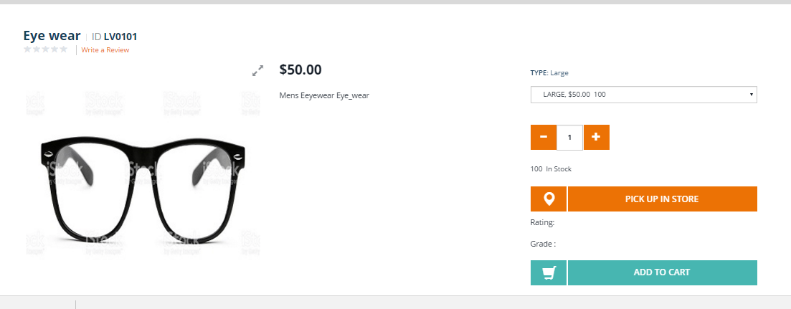
Hot Folder
Hybris supports hot folders which are folders from which data can be automatically imported into Hybris by simply placing the data inside of the folder.
Implementation
Testing the hotFolder .

Slide 29
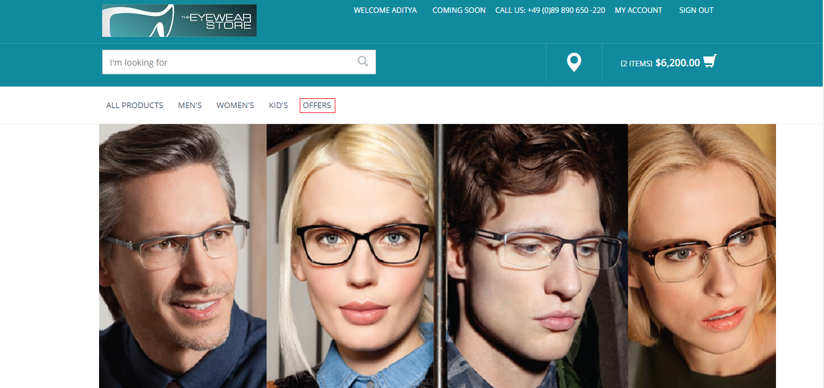
WCMS COCKPIT CUSTOMIZATION
Here we will be creating a new Page , a new Link and a new Component by creating a new Template.
Now we have to create a new page and link it in the site so that user can click that link and our offer page gets displayed with the fresh offers.
Firstly we were create a Node named Offers in the NavigationBar which will redirect us to the Offers Page.

Slide 30
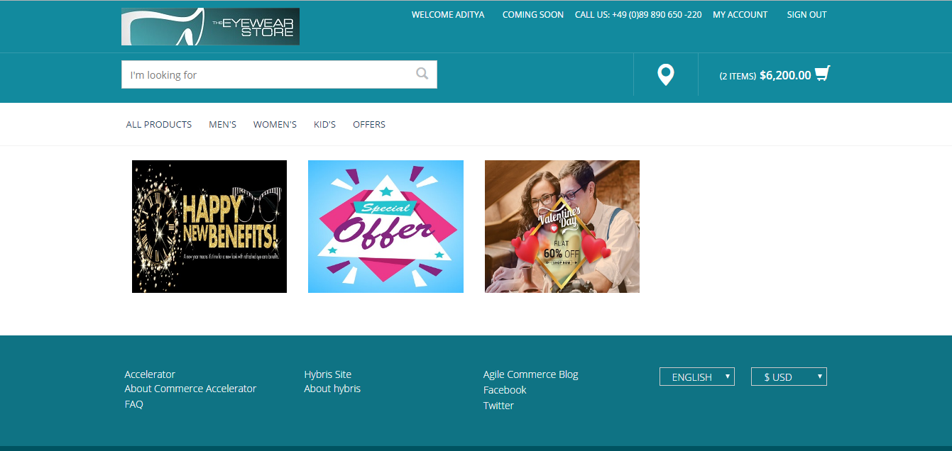
AFTER CLICKING ON OFFERS THE OFFERSPAGECONTROLLER WILL BE CALLED WHICH WILL REDIRECT US TO THE JSP PAGE(OFFERSLAYOUTPAGE).

Slide 31
Thank You

